Slide 1
Introduction to Quantum Computing: From a Layperson to a Programmer in 30 Steps
Hiu-Yung Wong
https://link.springer.com/book/10.1007/978-3-030-98339-0
https://www.amazon.com/Introduction-Quantum-Computing-Layperson-Programmer/dp/3030983382
Playlist: https://www.youtube.com/watch?v=l3UklDWGXT4&list=PLnK6MrIqGXsJfcBdppW3CKJ858zR8P4eP&index=29
https://www.youtube.com/watch?v=uaJbk9pdA3I&list=PLnK6MrIqGXsJfcBdppW3CKJ858zR8P4eP&index=30

Slide 2
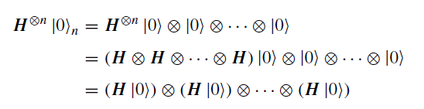
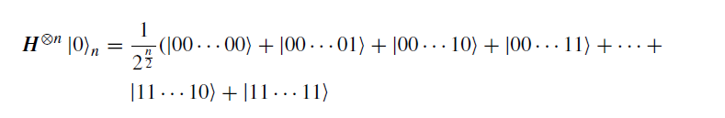
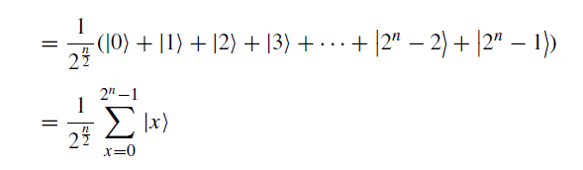
n-bit Hadamad Gate on |00…0> (n-zeros)

Slide 3






H_{n} Operates on arbitrary n‐bit basis
Introduction to Quantum Computing: From a Layperson to a Programmer in 30 Steps
6

Slide 4
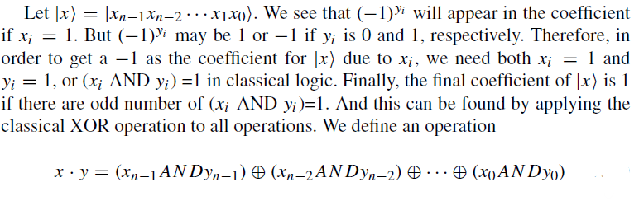

Introduction to Quantum Computing: From a Layperson to a Programmer in 30 Steps

Slide 5
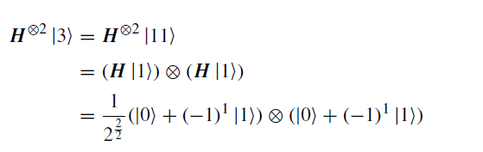

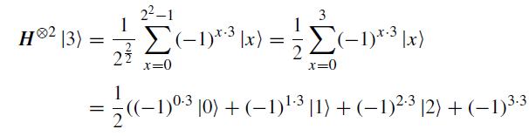

Example: 3 Methods to Calculate H Operation
Method 1
Method 2
Introduction to Quantum Computing: From a Layperson to a Programmer in 30 Steps

Slide 6
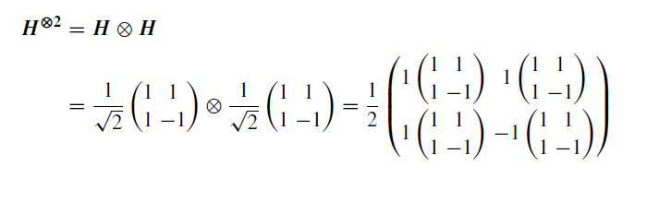
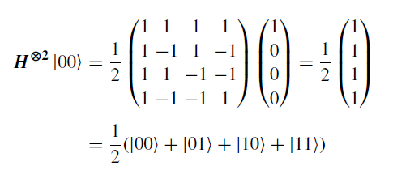
Method 3

